Slide 1
I400 – Application Development in Java
Lecture 8

Slide 2
Today
CH 11 – Inheritance
Superclasses & subclasses
Super
Overriding
Instanceof
.equals()

Slide 3
Inheritance
Like Python, Java allows you to avoid duplicating code by creating superclasses (parent classes) that can be extended by subclasses (child classes).
Inheritance is a good choice when you want to model several things that exist in an “is-a” relationship with a common object.
An Employee is a Person, a Student is a Person, a Visitor is a Person.

Slide 4
Inheritance
In this case, we say that Employee, Student, and Visitor are subtypes of Person, which is their supertype.
Person
Extends
Employee
Student
Visitor

Slide 5
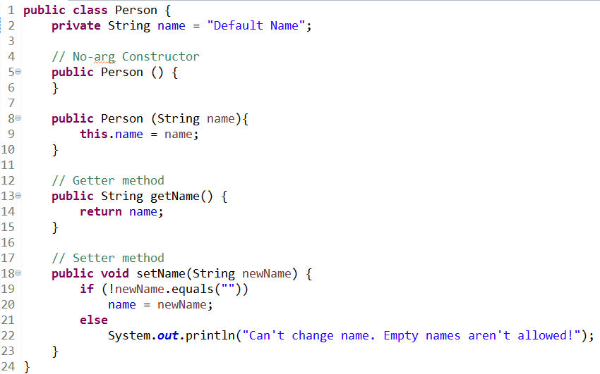
Inheritance
Here’s our superclass, Person:

Slide 6

Inheritance
Unlike in Python, a subclass in Java doesn’t get access to private methods or data fields.
If we set up public access methods & mutators correctly, we can simply use those.

Slide 7
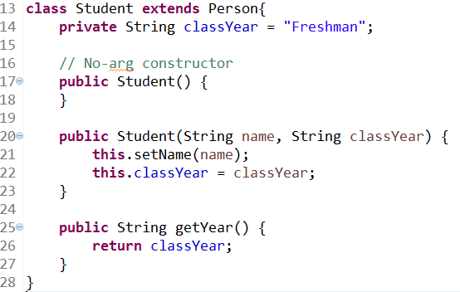
Inheritance
And our subclass, Student, which uses the extends keyword.
We can use methods from the superclass.

Slide 8
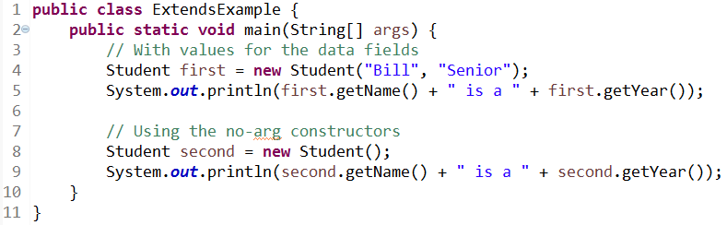

Inheritance
We create some Students:
Notice the output:
To get this, the constructor for Student also had to invoke the constructor for Person.

Slide 9
The super method
Like Python, Java supports the super() method for invoking methods from the superclass.
If you want to invoke a constructor from the superclass, the super() method must appear on the first line.

Slide 10
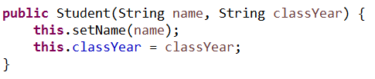

The super method
We can re-write the constructor of Student to use super() :
Now, the entire constructor from Person is run, which could be useful if we add more functionality later.

Slide 11
Overriding
Overriding is when a subclass modifies the implementation of a method from the superclass. The methods must have the same name and list of parameters.
If you want to preserve functionality from the superclass, you can use the super() method to invoke the superclass’ version.

Slide 12
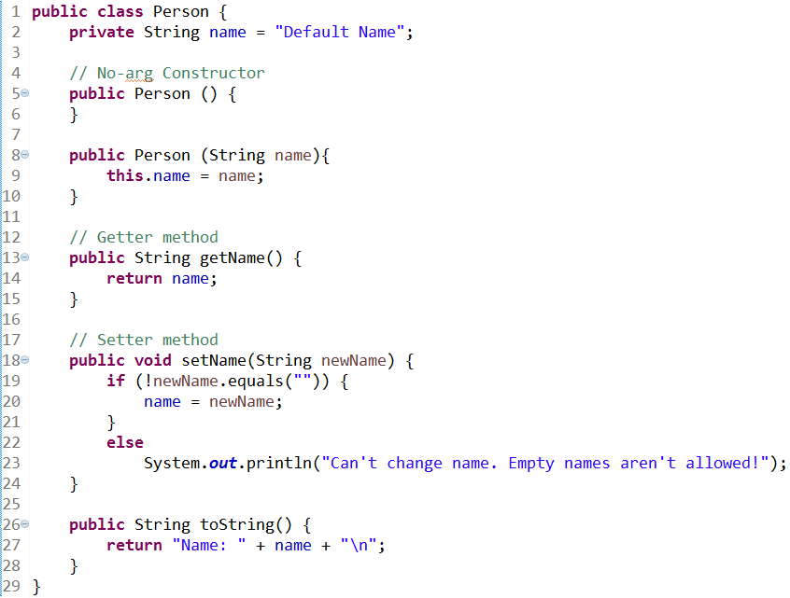
Overriding
Let’s say we add a toString() to Person:

Slide 13
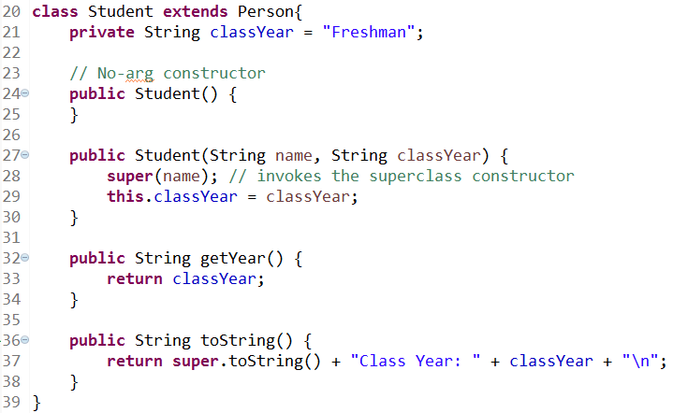
Overriding
We can override the toString() method in Student, adding to the original functionality:

Slide 14
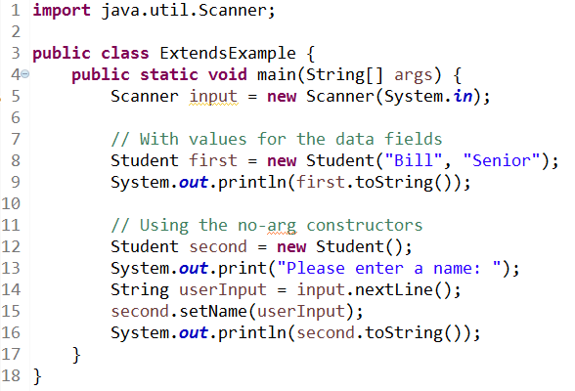
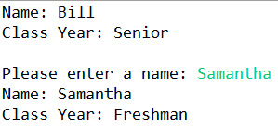
Overriding
The output of our test code shows the new result. Only the last line of each toString() call comes from new code in Student.

Slide 15

@Override
One mistake we could make is to override a method in a subclass that we never got around to writing in the superclass!
@Override is an annotation that requires a method with the same signature to exist in the parent class.

Slide 16
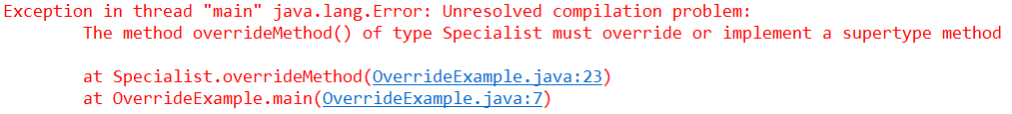
@Override
If we forgot to write the method in the superclass, OR we mis-typed the name, it’s caught at compilation:

Slide 17

toString()
The toString() method is inherited from Object, the base object class.
If no implementation of toString() is given inside of a class, the default value is the class name and a memory reference:

Slide 18
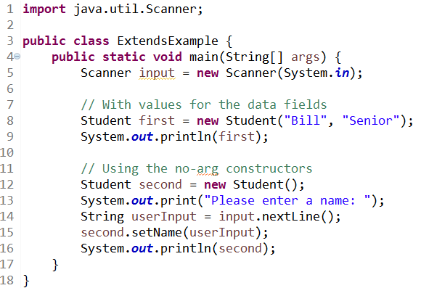
toString()
Once we’ve written a toString() method in a class, print() and println() can invoke it automatically (without needing the call):

Slide 19

Employee (Group Work)
Extend the Person class to cover a new subclass, Employee.
An Employee has a name (String), a job title (String), and a salary (int).
Add a no-arg and a normal constructor, then override the parent’s toString():
Starter code is on Canvas as TestEmployee.java.

Slide 20
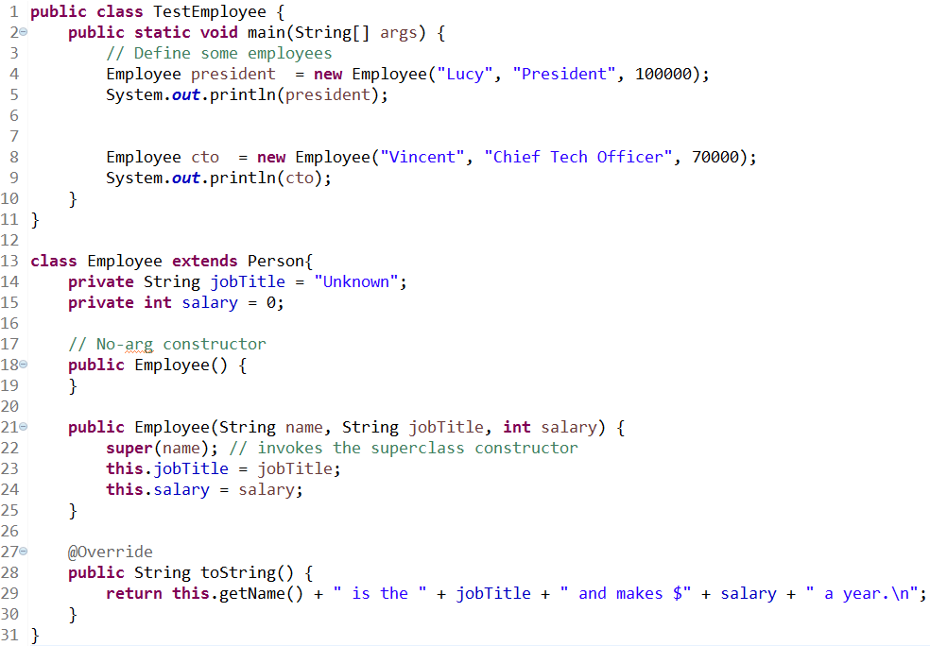
Employee (Solution)

Slide 21
Object Casting
Every instance of a subclass is also an instance of its superclass!
This means you can cast an object to the type of its superclass (upcasting). You can also cast an object to the type of its subclass (downcasting).
Upcasting can happen implicitly, but downcasting needs to use our normal casting syntax.

Slide 22
instanceof
We can also write methods that operate on the superclass type, and still include code in there that cares about the subtype!
If we’re going to need to cast to a subtype, it’s best to check that the object we’re working with can be cast in that manner.
That’s where the instanceof keyword comes in.

Slide 23
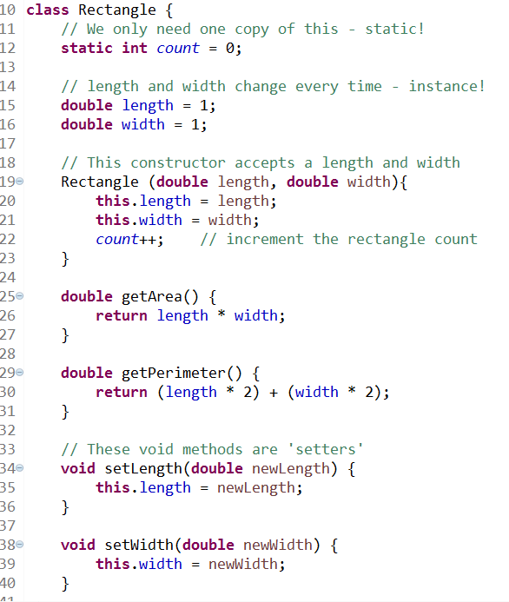
instanceof
Remember the Rectangle class?

Slide 24
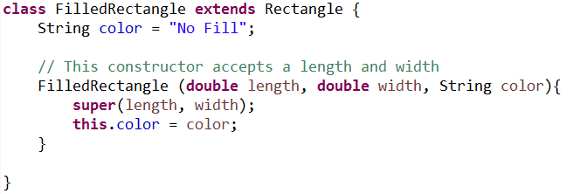
instanceof
If we extend the Rectangle class to add more information:
It might be nice to have a toString() method in the original class that can tell these apart!

Slide 25
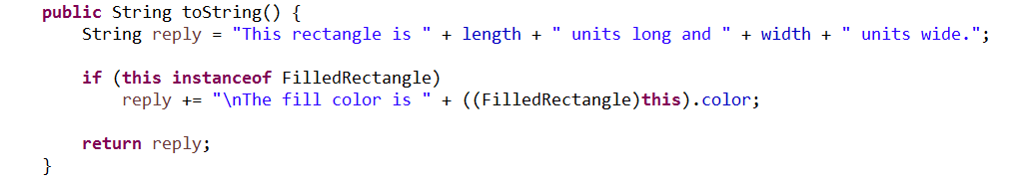
instanceof
Notice how we check before casting:

Slide 26
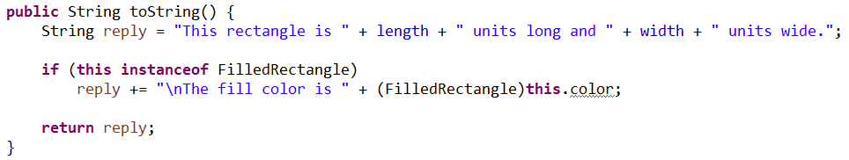
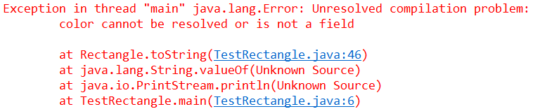
instanceof
An easy mistake is to forget the parentheses that force the casting to happen first!

Slide 27
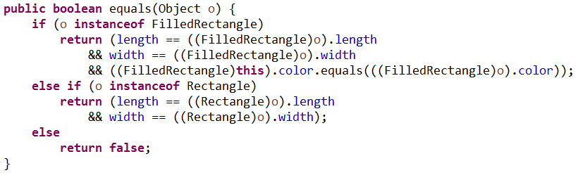
.equals()
Depending on our goals, it may be worth overriding the default notion of equality for objects (do they have the same memory reference?) This code goes inside Rectangle:

Slide 28
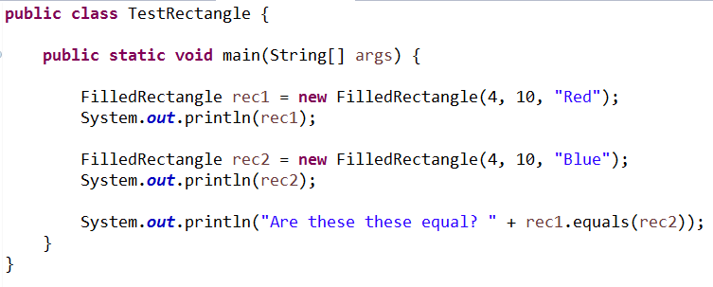
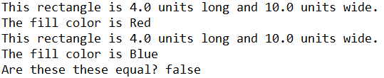
.equals()
We can now test for equality:

Slide 29
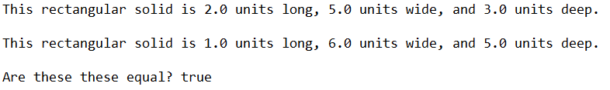
Rectangular Solid (Group Work)
Create a subclass of Rectangle called RectangularSolid. In addition to a length and width, RectangularSolids also have a depth.
Create an access method called getVolume() that returns the RectangularSolid’s volume.
Override the parent’s toString() method.
Override the parent’s equals() method. Two RectangularSolids are equal if they have the same volume.
Starter code is on Canvas as ExtendRectangle.java, and should produce this output:

Slide 30
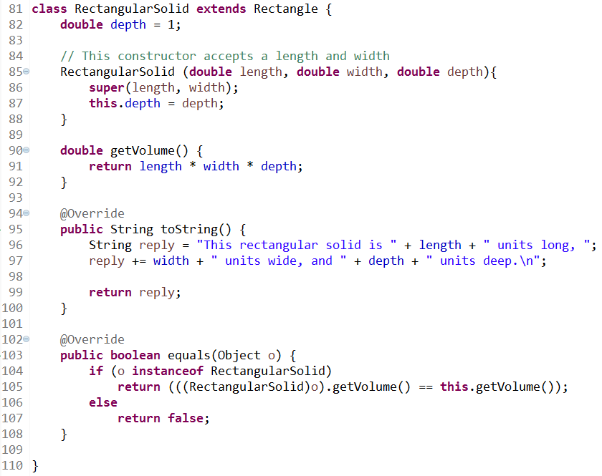
Rectangular Solid (Solution)

Slide 31
Questions?

